Slide 1

CS-3103 : Operating Systems : Sec-A (NB) :
File Systems…..

Slide 2

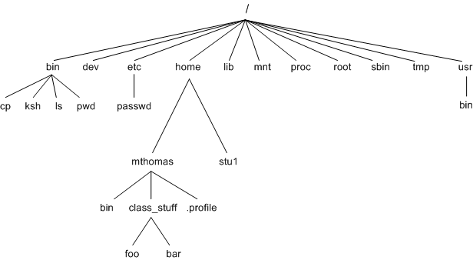
When information is stored on permanent magnetic media, like a tape or hard disk, it is called a file.
Ex: The source code of a C program is an instance of a text file.
Operating Systems

Slide 3
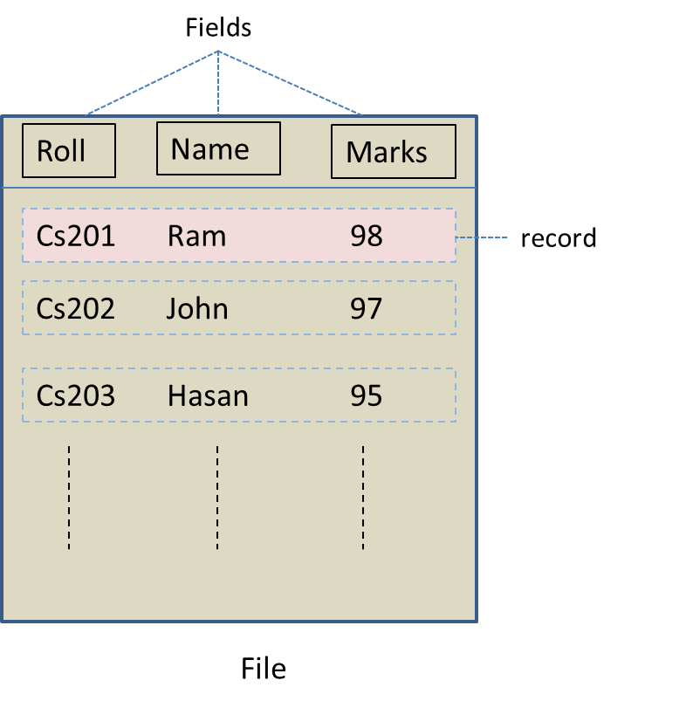
File Organisation
A set of data items that collectively define an entity is called a record.
The entity can be a person, event, place, etc. An individual data item within a record is called a field.
The field that uniquely identifies a record within a file is called a key field.
A file of records
Operating Systems

Slide 4
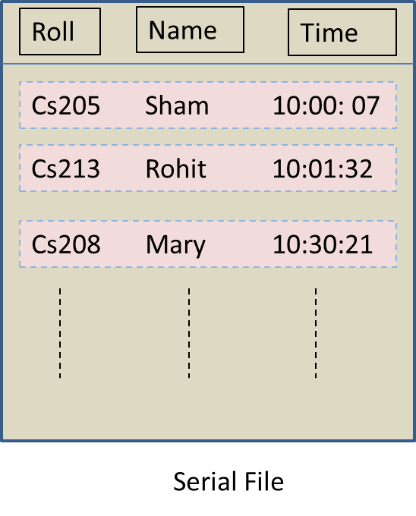
Serial Files
Records are stored in the order of their arrival.
Example: In a booking window, the records of the customers are stored in a file in the order of arrival of the customers.
A serial file is useful for situations where almost all records of the file need to be processed.
Operating Systems

Slide 5
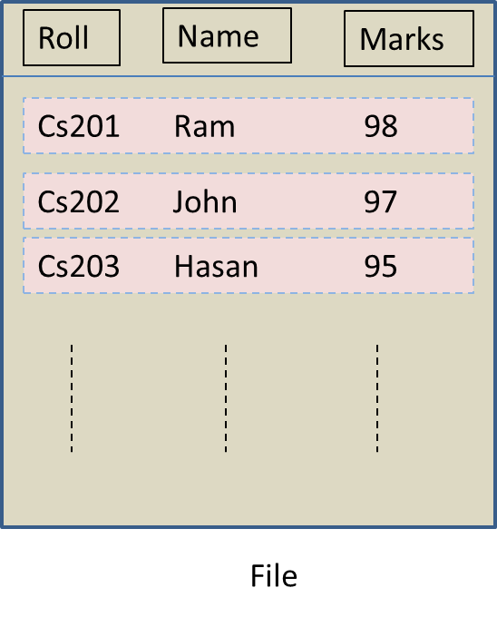

Sequential Files
The records in a sequential file are stored in a meaningful order of a key field.
The only way to reach a particular record is by searching the file from the beginning and skipping the records till the desired record is reached.
A sequential file
Operating Systems

Slide 6
Disadvantages of Sequential Files
The main disadvantage is that records cannot be deleted, inserted or modified in an existing sequential file.
In order to overcome this limitation, the existing sequential file is given the name Old Master File (OMF).
The records that need to be changed are read from the OMF into main memory.
The records are then updated and stored, in the same sequence, in a separate file called the transaction file (TF).
Operating Systems

Slide 7
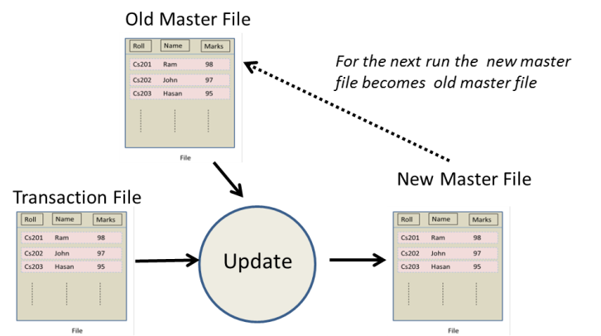
Transaction Processing in Sequential Files
Operating Systems

Slide 8
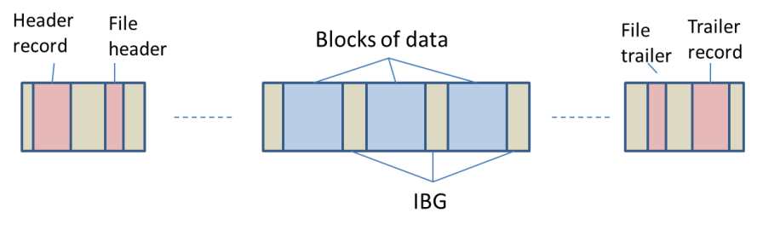
A Sequential File on a Tape
A file held on a magnetic tape has the following three components:
A header record, containing identification information about the tape.
Blocks of data, where a block may contain one or more records depending upon the block size supported by the OS.
A trailer record marking the end of the tape.
Between two consecutive blocks of data, there is an interblock gap (IBG), that marks the end and beginning of blocks and allows the tape drive to detect the start and end of a block.
Operating Systems

Slide 9
Advantages of Sequential Files
Simple design
One key field is enough to identify and search a record within the file
Very efficient organisation
Inexpensive way of storing data on tapes
Operating Systems

Slide 10
Disadvantages of Sequential Files
More time is taken to access the desired record.
The entire file is read to reach the record.
Processing and updating of records is performed in a separate file called the transaction file.
Transactions have to be sorted before processing is done.
The file is never up to date.
Overall processing is slow.
Operating Systems

Slide 11
Indexed Sequential Files
The records are stored sequentially on separate blocks on the hard disk.
Each block contains a specified number of records.
A block can be reached through an entry into an index.
The index is also stored on the disk.
Each entry into the index contains only two items:
  The key field of the last record present in a block
  The starting disk address of the block
Operating Systems

Slide 12
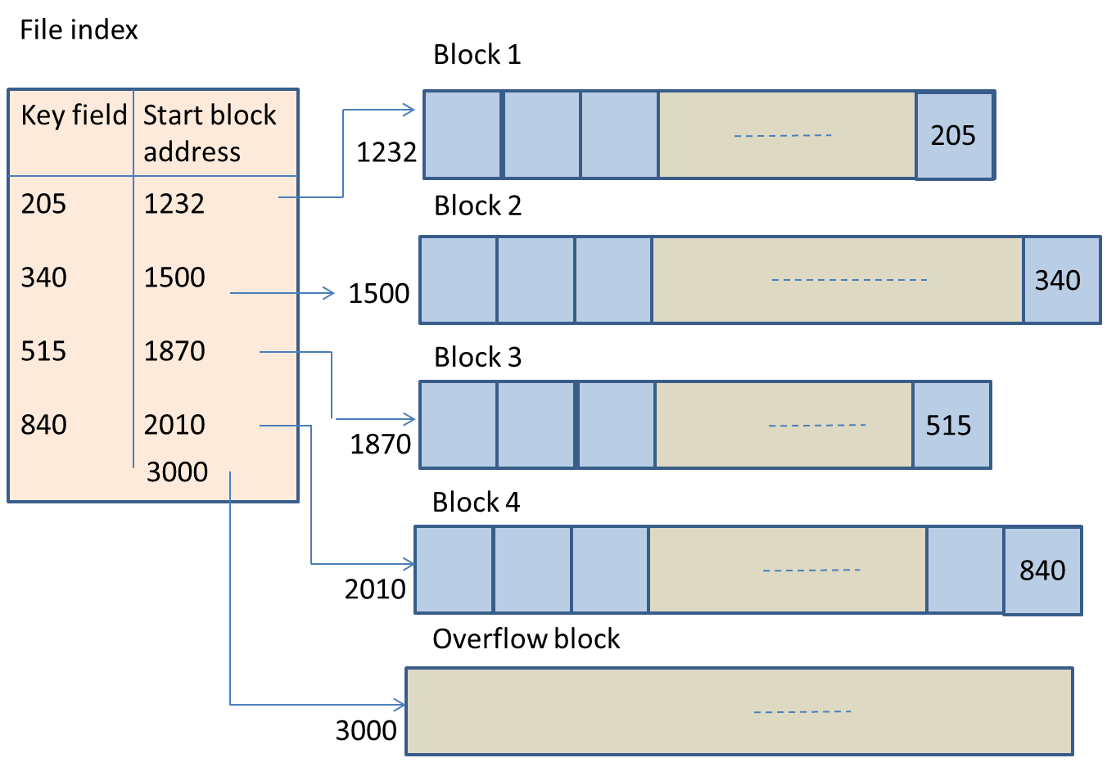
Indexed Sequential Files
Operating Systems

Slide 13
Advantages of Indexed Sequential Files
Access to a record is faster than in sequential files
Provides a good combination of direct and sequential processing of the same file
Interactive processing is possible
Very suitable for disk storage
Operating Systems

Slide 14
Disadvantages of Indexed Sequential Files
Indexed sequential files generate overflows because of insertion operations.
During deletion, vacant storage locations are created in blocks.
Extra storage space is required to store the ‘index’ of the file.
Frequently, the file needs to be reorganised to remove the blank storage locations.
Operating Systems

Slide 15
Direct File Organisation
Allows records to be read directly from or written onto the file without proceeding from the beginning.
For a given record, an address is generated by applying a mathematical function on the key field of the record.
This mathematical function is called the hash function.
The hash function generates a unique disk address for the given record and thereafter, the record is stored at that address.
Operating Systems

Slide 16
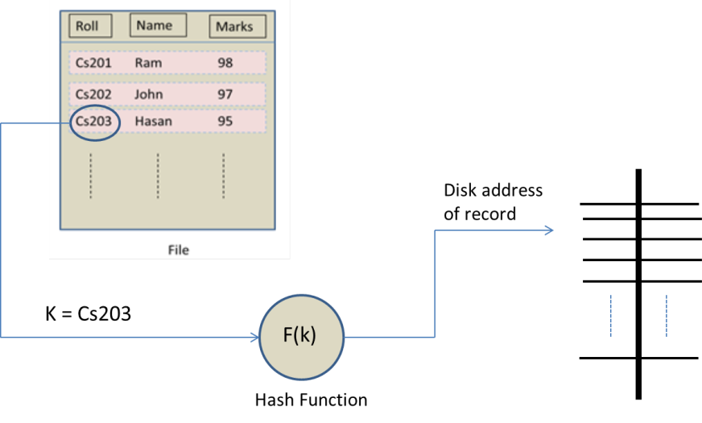
Direct File Organisation
Operating Systems

Slide 17
Advantages of Direct Files
Any record can be directly accessed.
File processing and updating are done in the same file without the creation of a New Master File (NMF).
Speed of processing of large files is very quick.
The files can be kept up-do-date because online updating of records is possible.
Concurrent processing of many files is possible.
Operating Systems

Slide 18
Disadvantages of Direct Files
Direct or random files are prone to security and backup problems.
A poor hash function may lead to excessive overflows.
Poor access time and memory overheads.
Operating Systems

Slide 19
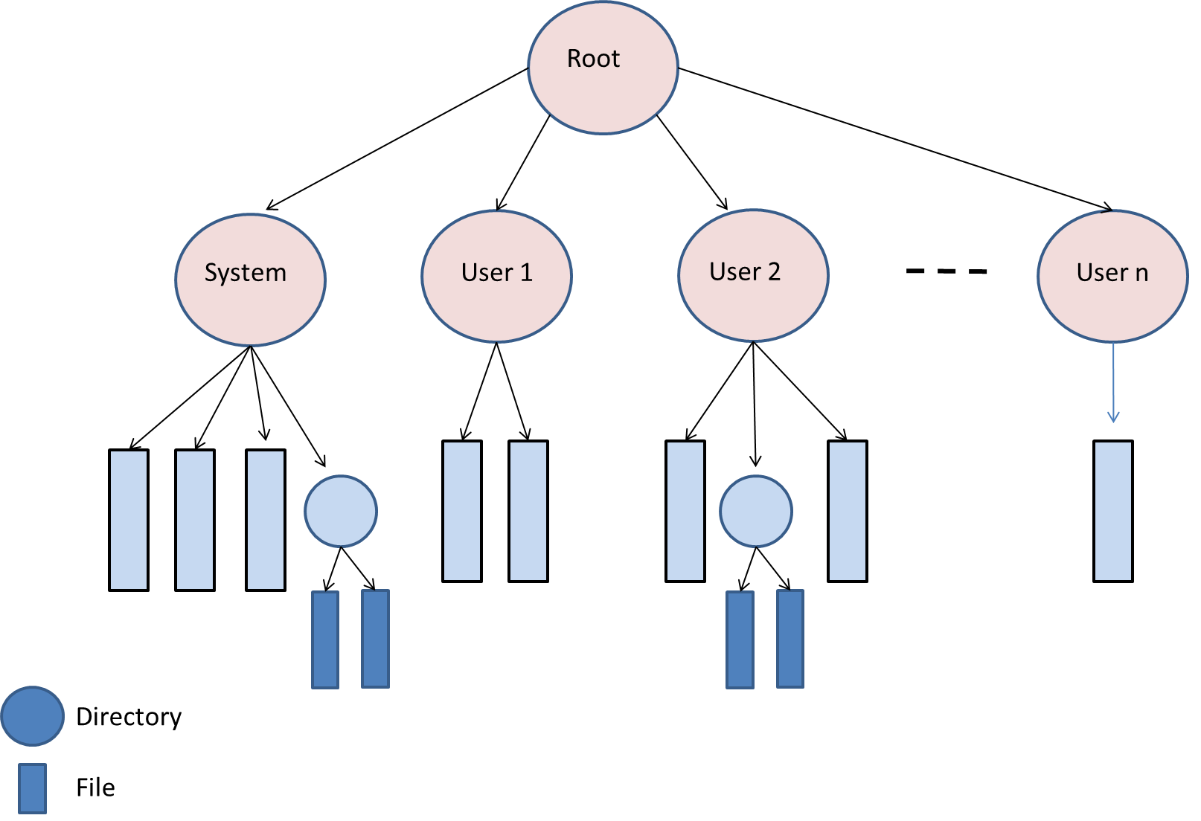
Files and Directories
On a particular logical drive, the files are further divided into groups.
Each group of files is stored in a separate area called the directory.
Files and directories
Operating Systems

Slide 20
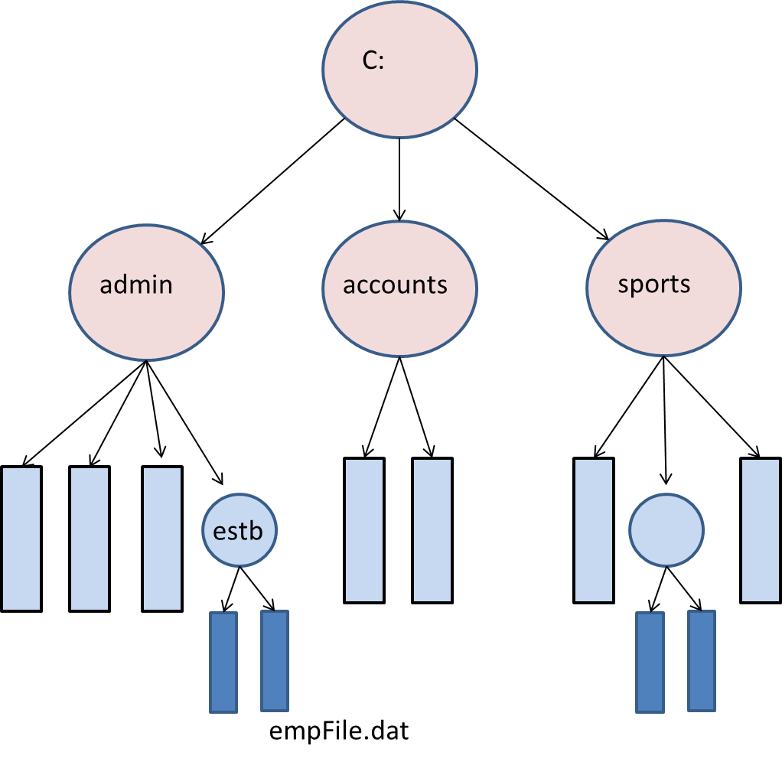
A Sample Directory Structure
Operating Systems

Slide 21
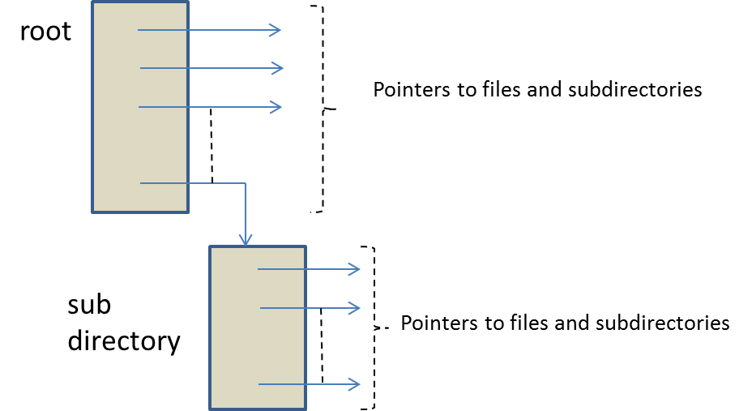
File Meta-data
The data structure of a directory is an array of records.
Each record has many fields, including a pointer that points either to a file or to a subdirectory.
Data structure of files and the directory system
Operating Systems

Slide 22
File System Functions
Open
Close
Read
Write
Erase
Append
Seek
Rewind
Rename
Delete
Operating Systems

Slide 23
Allocation of Disk Space to Files
The file system allocates disk space to files as per two broad policies:
  Contiguous allocation
  Non-contiguous allocation
Operating Systems

Slide 24
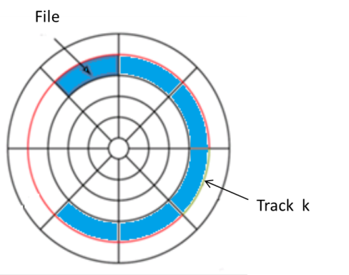
Contiguous Allocation
The space a file is allocated is in the form of contiguous blocks on the disk.
If the file spans over some sectors, then contiguous sectors are located on the disk to store the file.
If the file is larger than a track, then it spills over to the next platter on the same cylinder, and so on.
Contiguous allocation of blocks
Operating Systems

Slide 25
Advantages of Contiguous Allocation
The size of the file remains fairly constant, contiguous allocation is efficient.
The files can be processed at a fast rate.
The file manager needs to know the address of the first block of the file. The address of the subsequent blocks can be easily computed by knowing the size of the block.
Operating Systems

Slide 26
Disadvantages of Contiguous File Allocation
File size varies with time, and it becomes difficult to find contiguous space that is large enough on the same track or cylinder to store the file.
When a file becomes larger than the allocated space on the disk, it is moved to a new location. The changes are accordingly updated in the file directory entry, making the system even slower.
Memory fragmentation
Storage compaction
Operating Systems

Slide 27
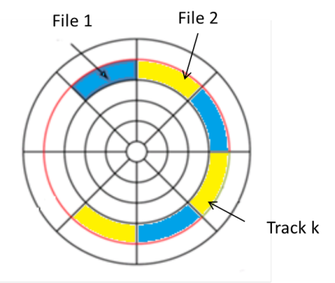
Interleaved Allocation
Some disk controllers cannot read two physically adjacent sectors.
By the time it detects the end of a sector, the R/W head crosses the beginning of the next sector.
In such cases, the blocks of files are stored in interleaved fashion.
Operating Systems

Slide 28
Non-contiguous Allocation
Modern disks avoid contiguous allocation of space.
The allocation of space to a file block is made as per the availability of space on the same platter or cylinder.
Some non-contiguous allocation strategies are :
  Linked allocation (block chaining)
  Indexed allocation
  Block-oriented file mapping
Operating Systems

Slide 29
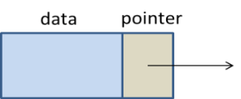
Linked Allocation (Block Chaining)
The file on the disk is organised in the form of blocks.
Each block contains two portions:
  Data part
  Pointer to the next block
The data part contains the record(s) of the file and the pointer points to the next block of the file.
A linked file block
Operating Systems

Slide 30
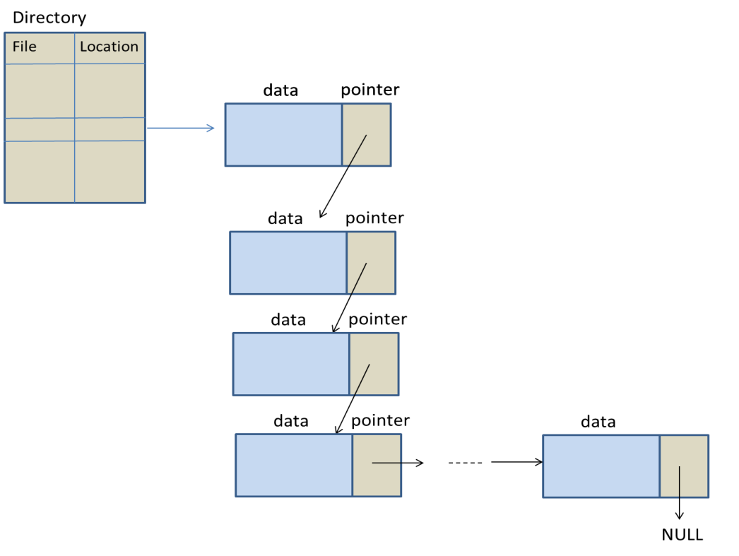
Block Chaining
Operating Systems

Slide 31
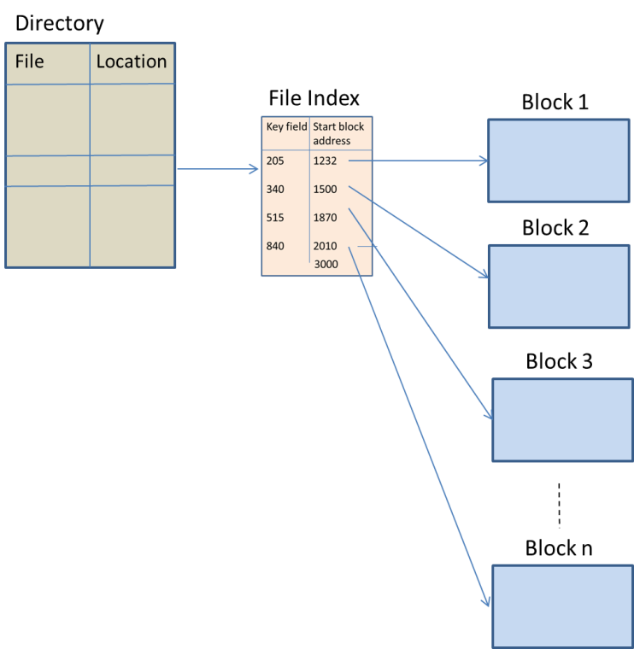
Indexed Allocation
An index for each file is maintained by the file manager.
The index contains pointers to the various blocks of the file.
Indexed allocation
Operating Systems

Slide 32
Drawback of Indexed Allocation
The main drawback is that insertion of a record may lead to a cascade of changes in the index entries of the file.
Operating Systems

Slide 33
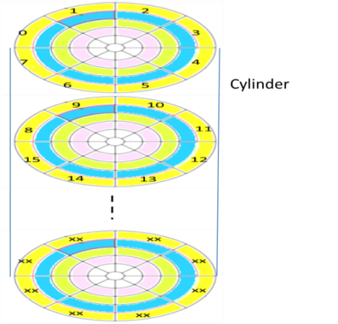
Block-oriented File Mapping
The disk is divided into blocks.
Each block is provided a unique number.
Instead of an index, this technique uses a file map.
It is an array of integers.
The subscripts of the array represent the block number and its contents can have three types of entries:
  Free
  Null
  Integer
Numbered blocks on the disk
Operating Systems

Slide 34
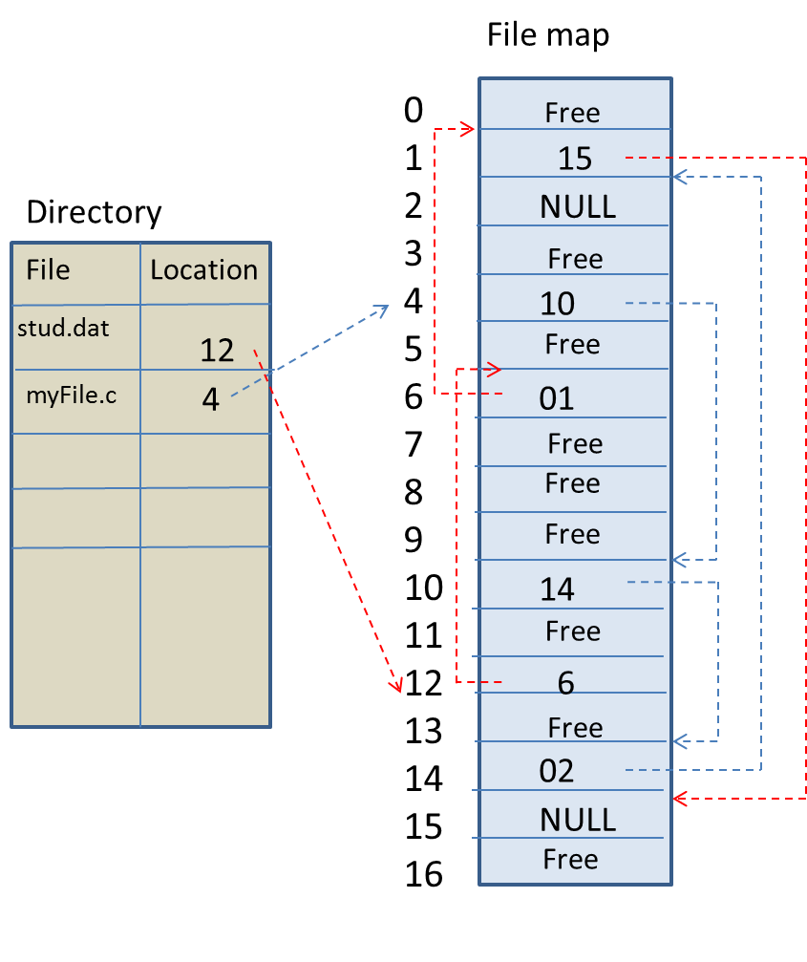
Block-oriented File Mapping
Operating Systems

Slide 35
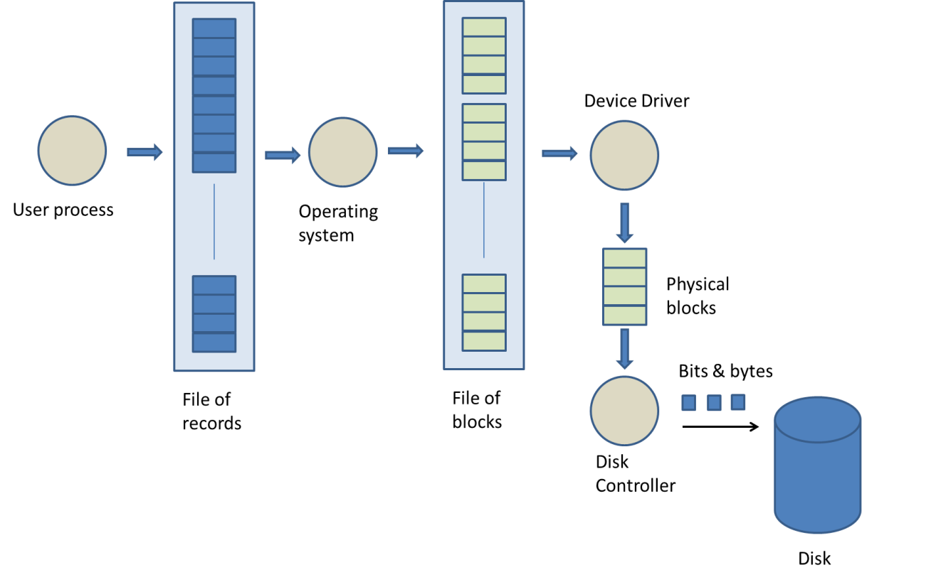
File System Architecture
The flow of a file in the computer system
Operating Systems

Slide 36
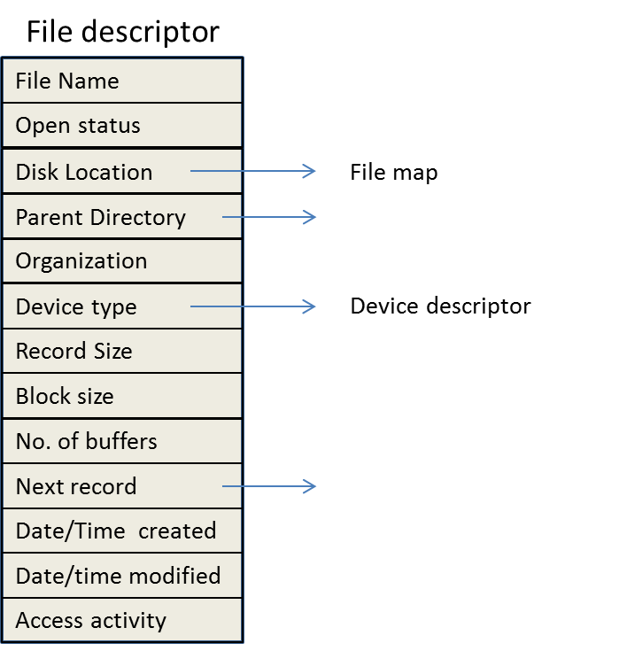
File System Data Structures
For every file stored in the disk, the operating system maintains a file descriptor (FD).
A typical file descriptor
Operating Systems

Slide 37
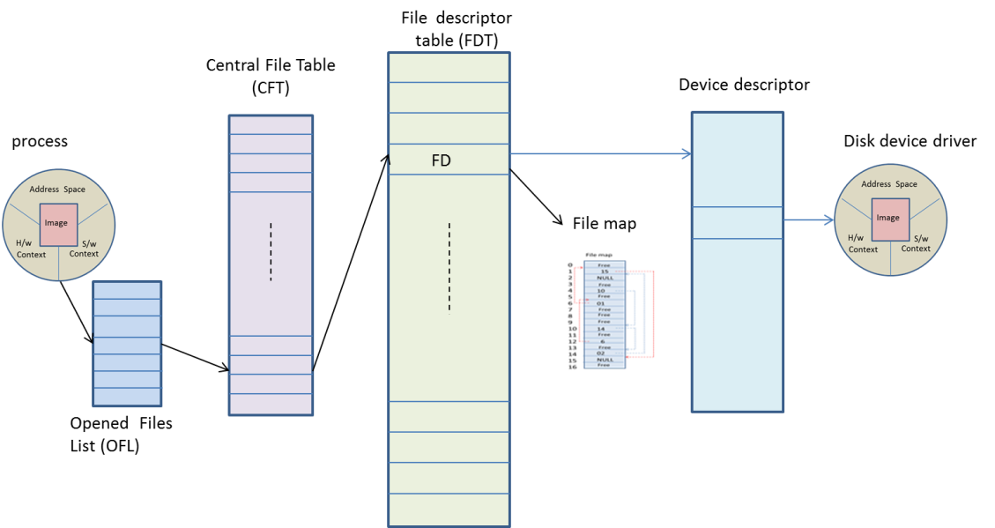
Data Structures of the File System
Operating Systems

Slide 38
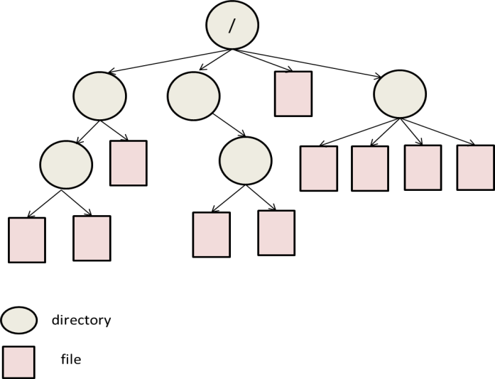
Unix File System
Unix supports a hierarchical file system wherein it has a root node at the top of the inverted tree.
The root directory contains a number of subdirectories and files.
The subdirectories further contain subdirectories and files and so on.
The hierarchical file structure
Operating Systems

Slide 39
Unix File System
Unix supports four types of files:
  Ordinary
  Directory
  Special
  FIFO
Unix assigns a data structure to every file that contains information about the file. The data structure is called the ‘inode’.
Operating Systems

Slide 40
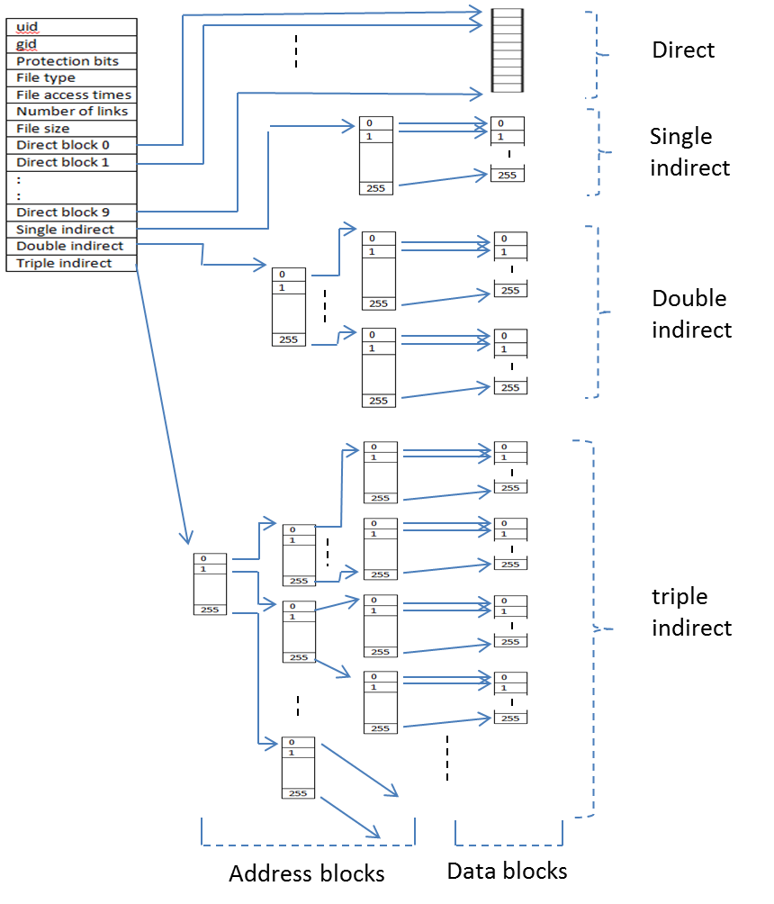
Inode Structure – Multiple Indirect Block Addressing
Operating Systems

Slide 41
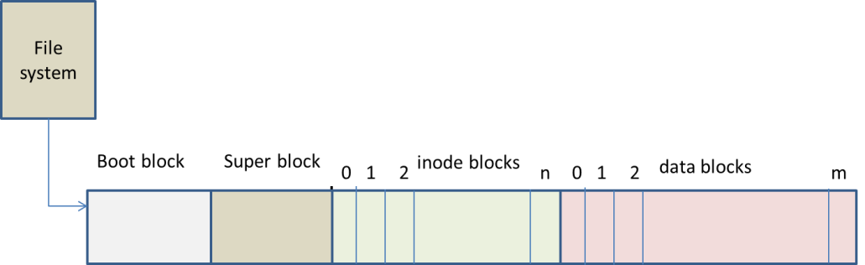
Unix File System Architecture
Unix supports multiple file systems. The root file system is permanent and others can be removed.
On the disk, a file system consists of four parts:
  Boot block
  Super block
  Index blocks 0–n
  Data blocks 0–m
Unix file system
Operating Systems

Slide 42
Linux File System
The Linux file system was designed to support the Minix file system.
The ability to concurrently support different file systems has been achieved with the help of the virtual file system (VFS).
VFS offers a general interface capable of interacting with the different types of file systems mounted on a system at any given time.
Every file is treated as an object and is assigned a symbolic name.
Operating Systems

Slide 43
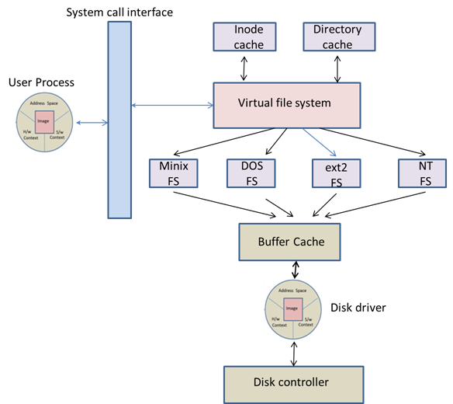
Virtual File System of Linux
Operating Systems

Slide 44
Windows File System
Windows mainly support three types of file systems:
  FAT (File allocation table)
  NTFS (New technology file system)
  HPFS (High performance file system)
Operating Systems

Slide 45
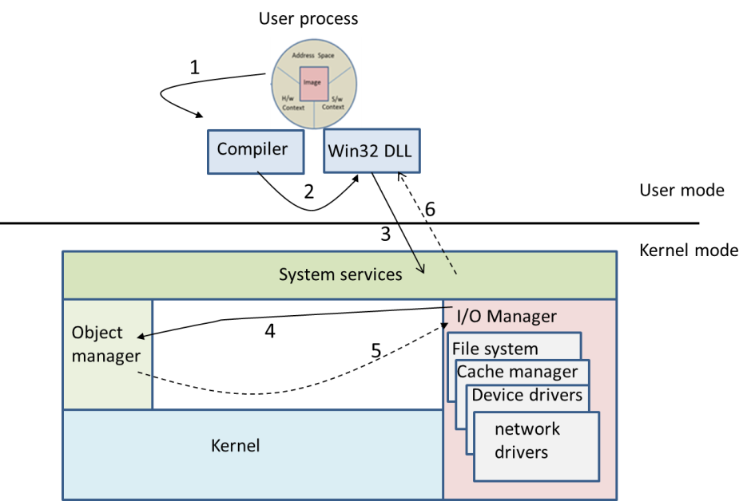
Opening a File in Windows
Operating Systems

Slide 46
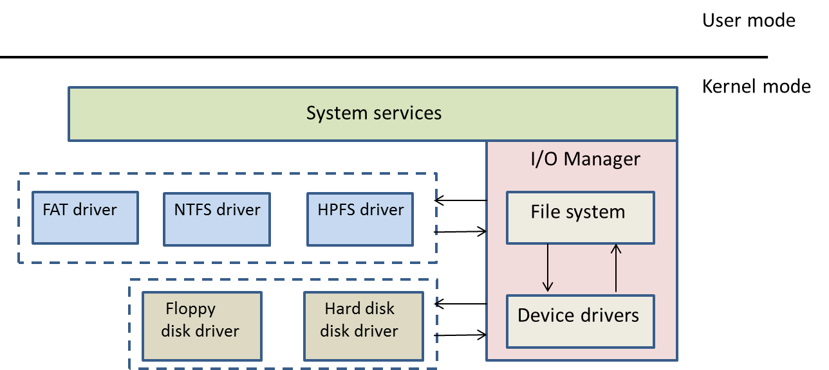
Two-layered Driver System
Operating Systems

